Slide 1
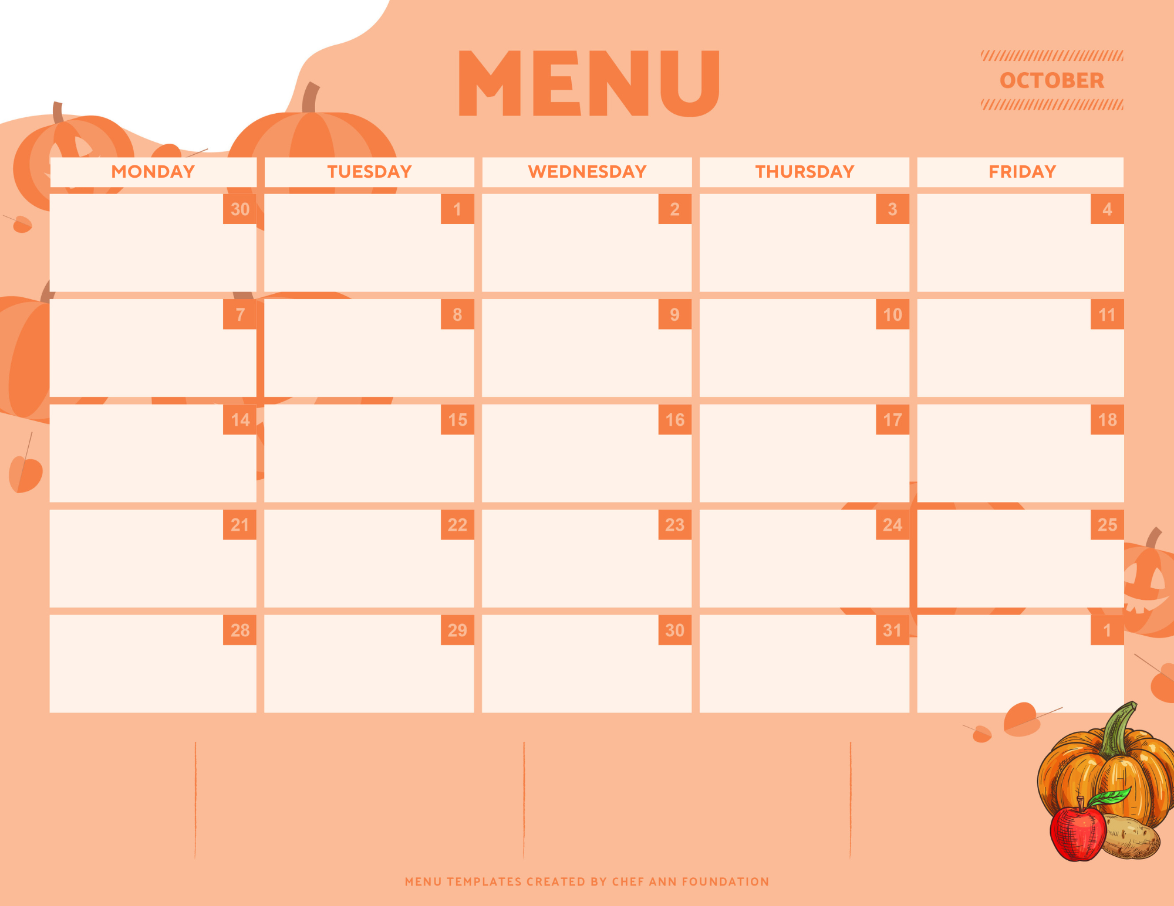
GSD Dinner
Hamburgers & Hotdogs
French Fries
Baked Beans
Coleslaw
Sandwich Trimmings
Donut Holes w/ Chocolate Icing
Beef & Chicken Nachos
Spanish Rice
Refried Beans w/ Cheese
Nacho Toppings
Fresh Fruit
Ice Cream
Turkey & Cheese Sub & Grilled Cheese Sandwich
Assorted Chips
Sandwich Trimmings
Fresh Fruit
Strawberry Cake
Fish Sandwich &
Crispy Chicken Sandwich
Tator Tots
Green Beans
Sandwich Trimmings
Fresh Fruit
Ice Cream
Chicken & Rice & BLT
Rolls
Buttered Corn
Parmesan Roasted Broccoli
Side Salad
Fresh Fruit & yogurt
Chocolatechip Cookie Cake
Pizza Sliders & Grilled Cheese Sandwiches
Assorted Chips
Side Salad
Pickles
Fresh Fruit
Iced Donut Holes
NO DINNER
Home-Going Day
Chicken Wings & Beef Ravioli
Dinner Roll
French Fries
Peas & Carrots
Fresh Fruit
Blueberry Donut Holes
Beef Lasagna & Cheese Calzones w/ Marinara
Garlic Toast
Buttered Corn
Roasted Brussel Sprouts
Side Salad
Chocolate Cake
Popcorn Chicken & Mozzarella Cheese Sticks
Mash Potatoes & Gravy
Green Beans
Fresh Fruit
Side Salad
Chocolate Chip Cookies
Philly Cheesesteak & Grilled Cheese Sandwich
Assorted Chips
Pickles
Fresh Fruit
Ice Cream
BBQ Rib Sandwich & BBQ Chicken Sandwich
Half Baked Potato
Baked Beans
Coleslaw
Fresh Fruit
Chocolate Chip Cookies
Breakfast For Dinner
Pancakes
Biscuits & Gravy
Bacon
Eggs
Cheese Grits
Fresh Fruit & Yogurt
Crack Chicken Pasta &
Cheese Calzones w/ Marinara
Garlic Breadsticks
Buttered Corn
Peas & Carrots
Fresh Fruit
Jello Cake
Chicken Bacon Ranch Roll-ups &
Turkey & Cheese Croissants
Assorted Chips
Sandwich Trimmings
Fresh Fruit
Ice Cream
Tator-Tot Casserole &
Peanut Butter & Jelly Sandwich
Green Beans
Macaroni & Cheese
Side Salad
Fresh Fruit
Lemon Cake
Chicken Quesadilla & Beef Buritos
Chips & Nacho Cheese
Refried Beans
Spanish Rice
Fresh Fruit
Cherry Jello
Cheeseburger Pasta & Cheese Calzones w/ Marinara
Garlic Toast
Peas & Carrots
Buttered Corn
Side Salad
Chocolate Chip Cookies
Chicken Salad Croissant & Grilled Turkey & Cheese Sandwich
Sandwich Trimmings
Assorted Chips
Fresh Fruit
Yogurt
Ice Cream
Milk, Tea, and Lemonade or Juice served every night
“This Institution is an Equal Opportunity Employer”
Menus are subject to change based on availability and Special Events occurring on Campus

